Slide 1
Completing the Hatchery Life Cycle

Slide 2
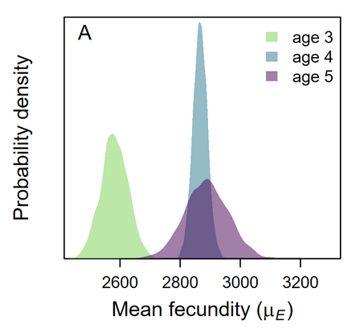
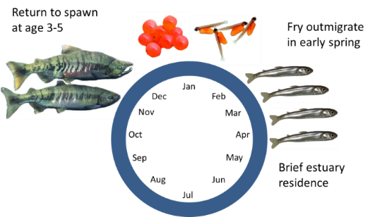
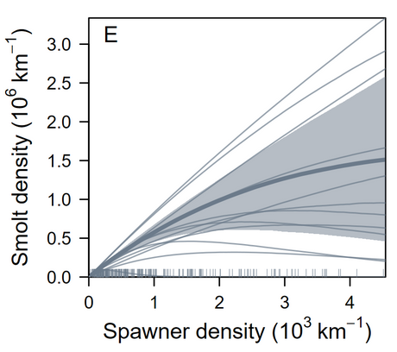
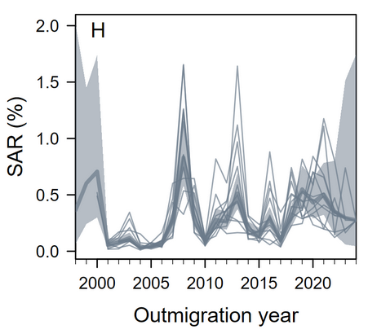
Broodstock
HOR
Spawners
Eggs
Age-5
Age-4
Age-3
Smolts

Slide 3
Broodstock
Spawners
Eggs
Age-5
Age-4
Age-3
Smolts
H Smolts

Slide 4
Broodstock
H Eggs
Spawners
Eggs
Age-5
Age-4
Age-3
Smolts
H Smolts

Slide 5
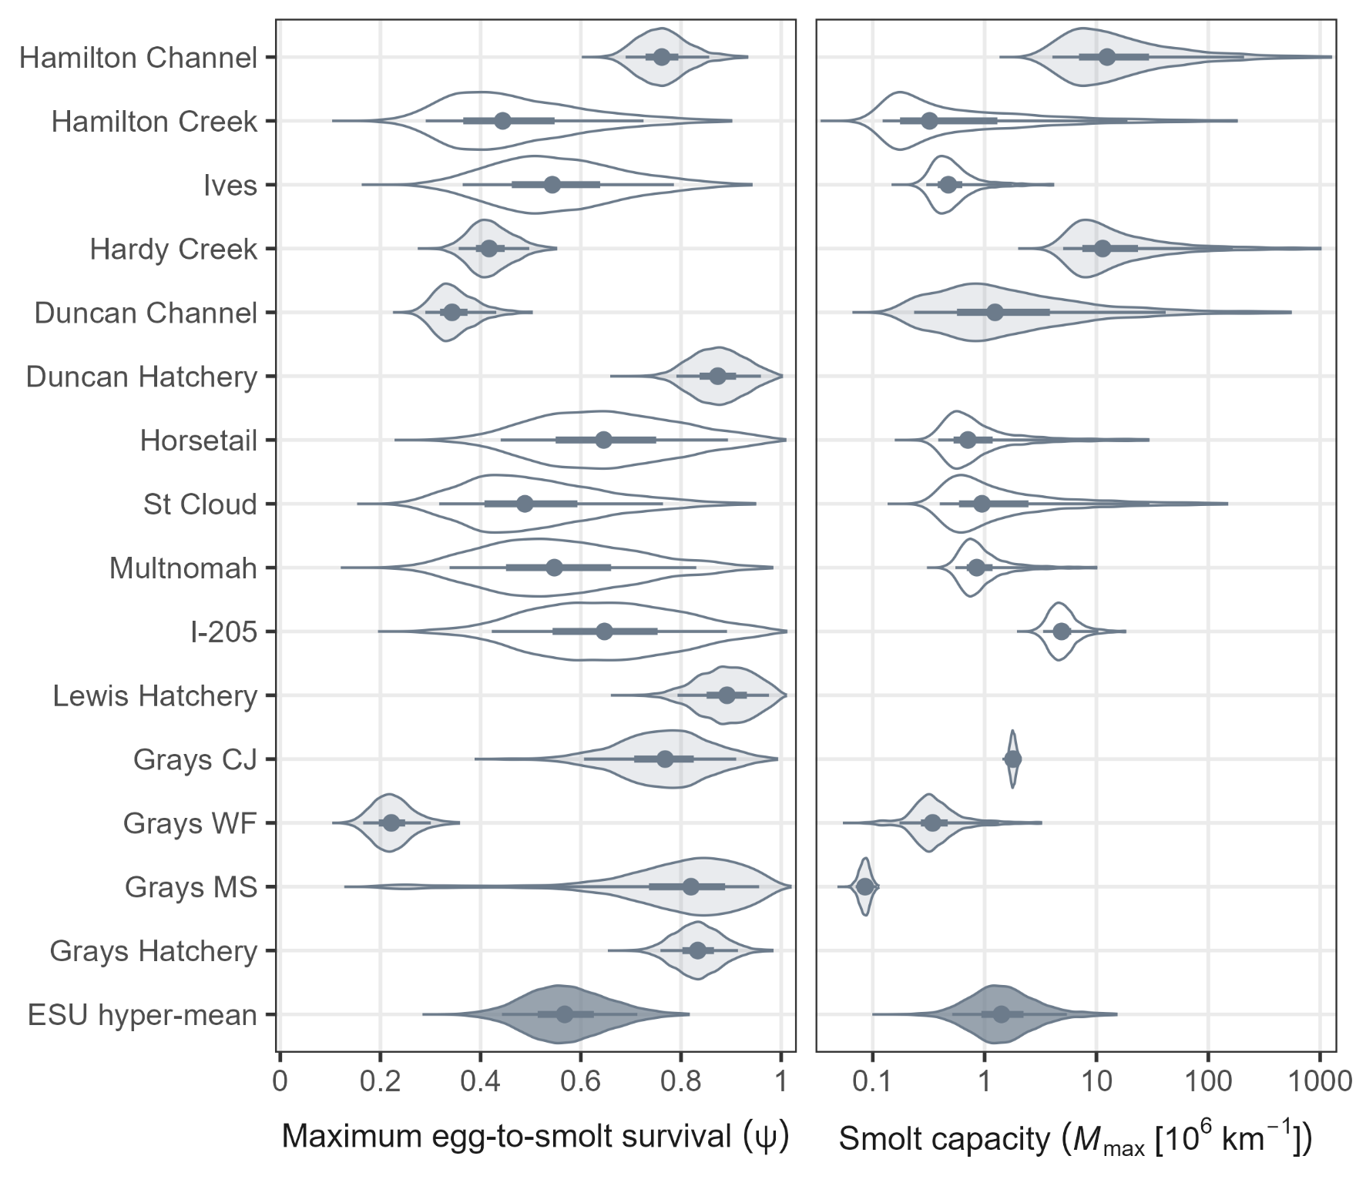

Slide 6
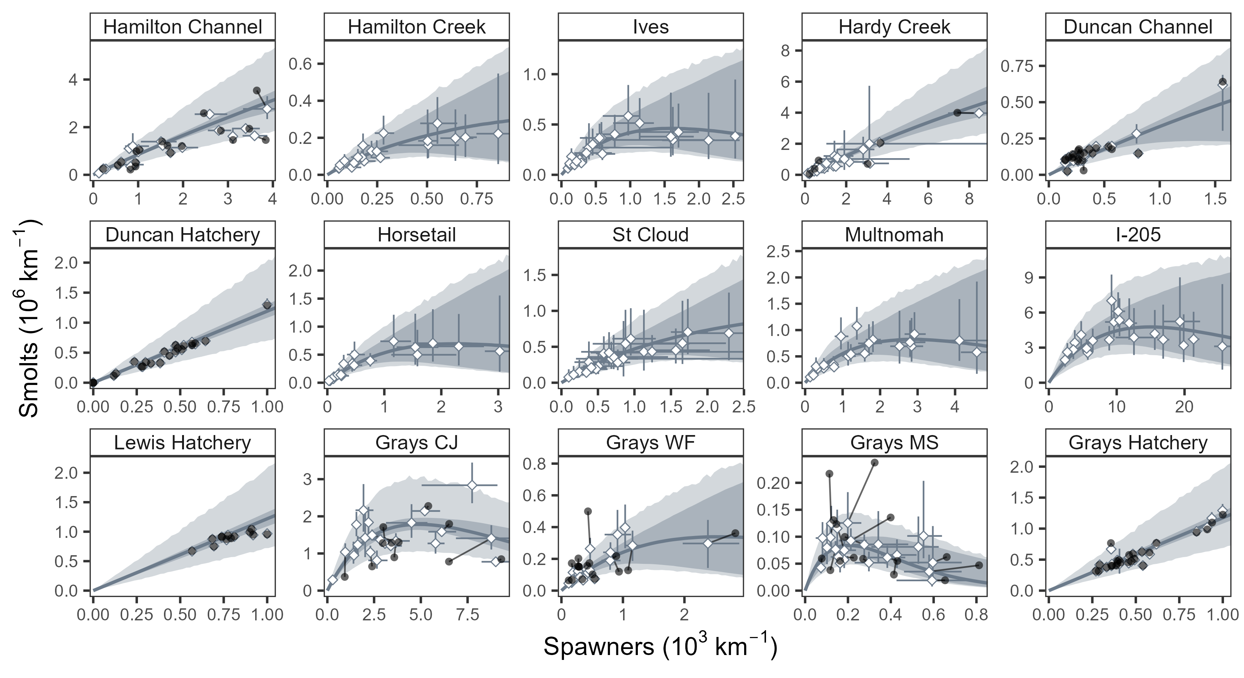

Slide 7
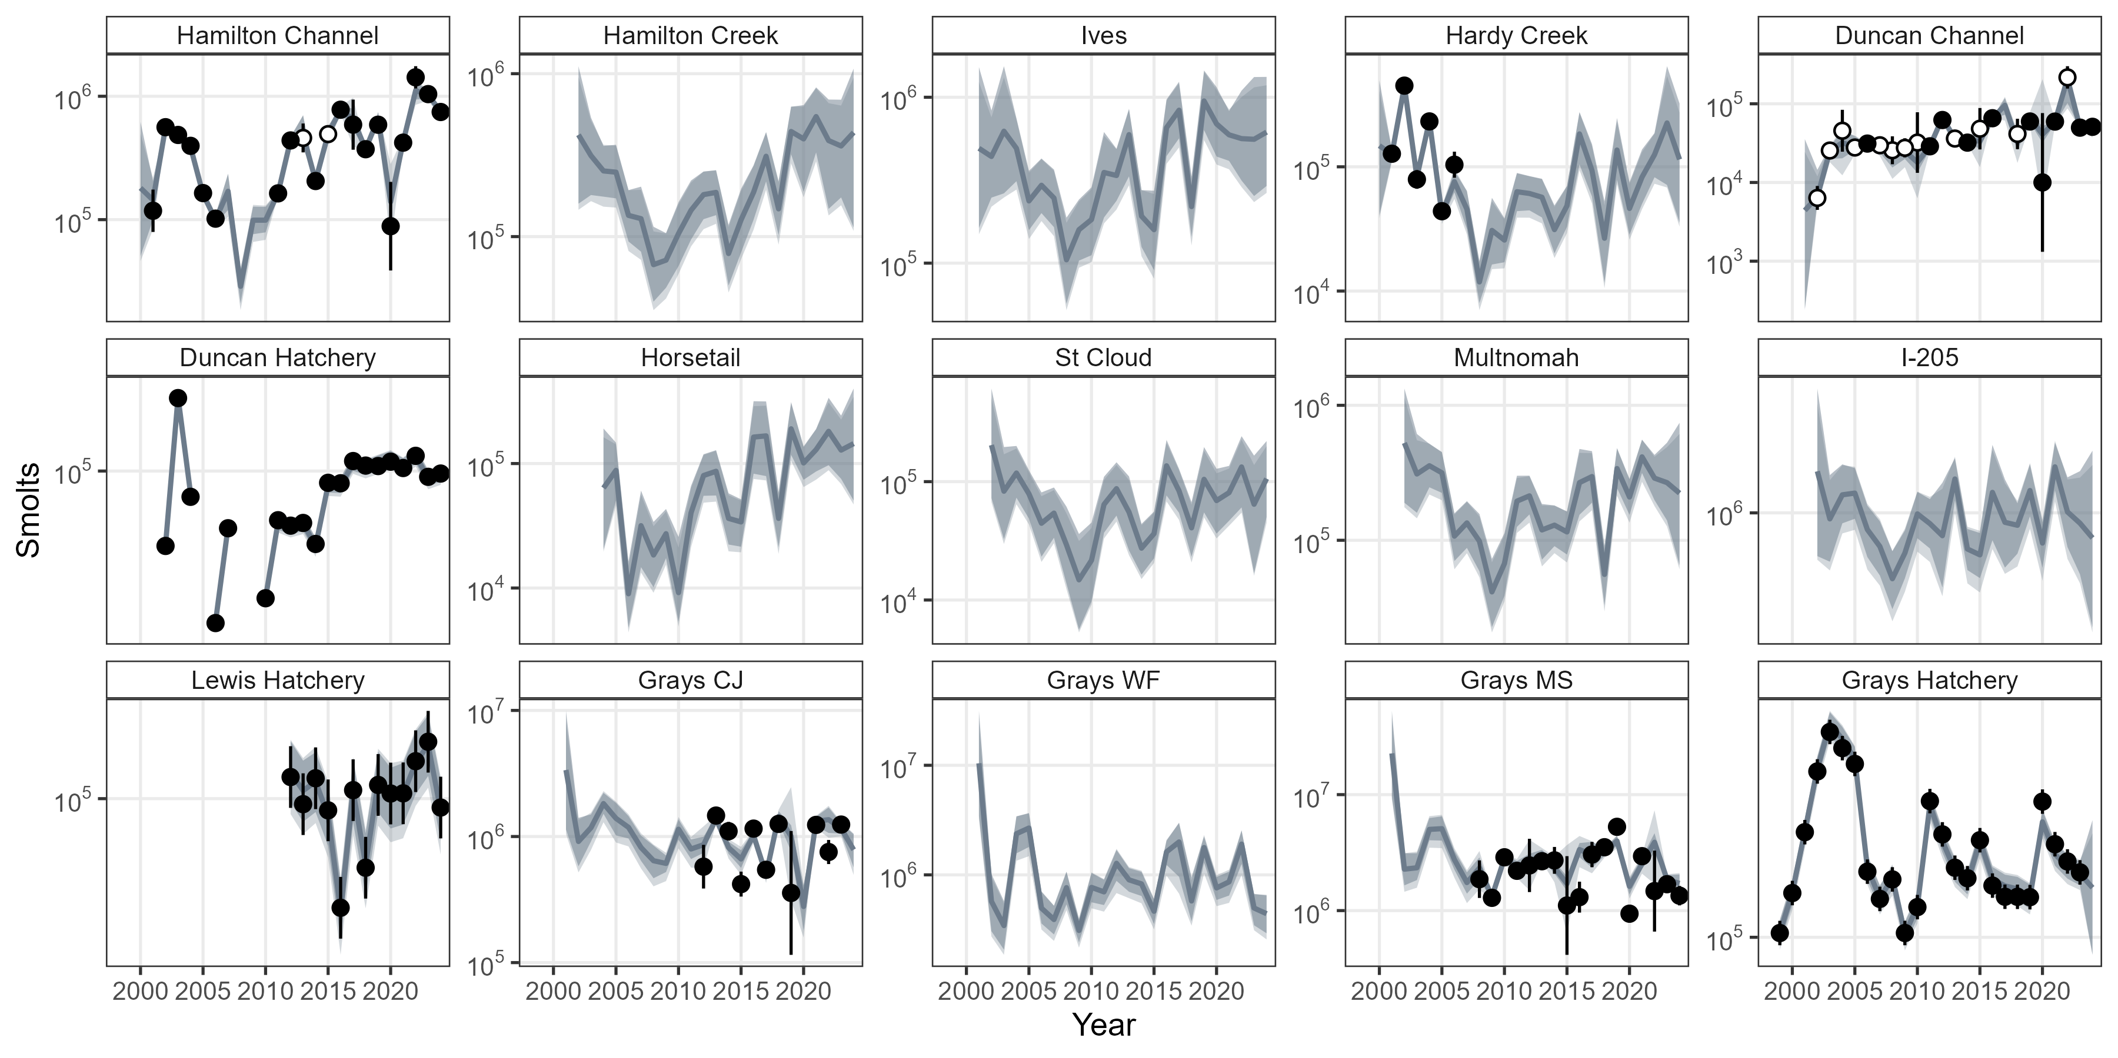

Slide 8
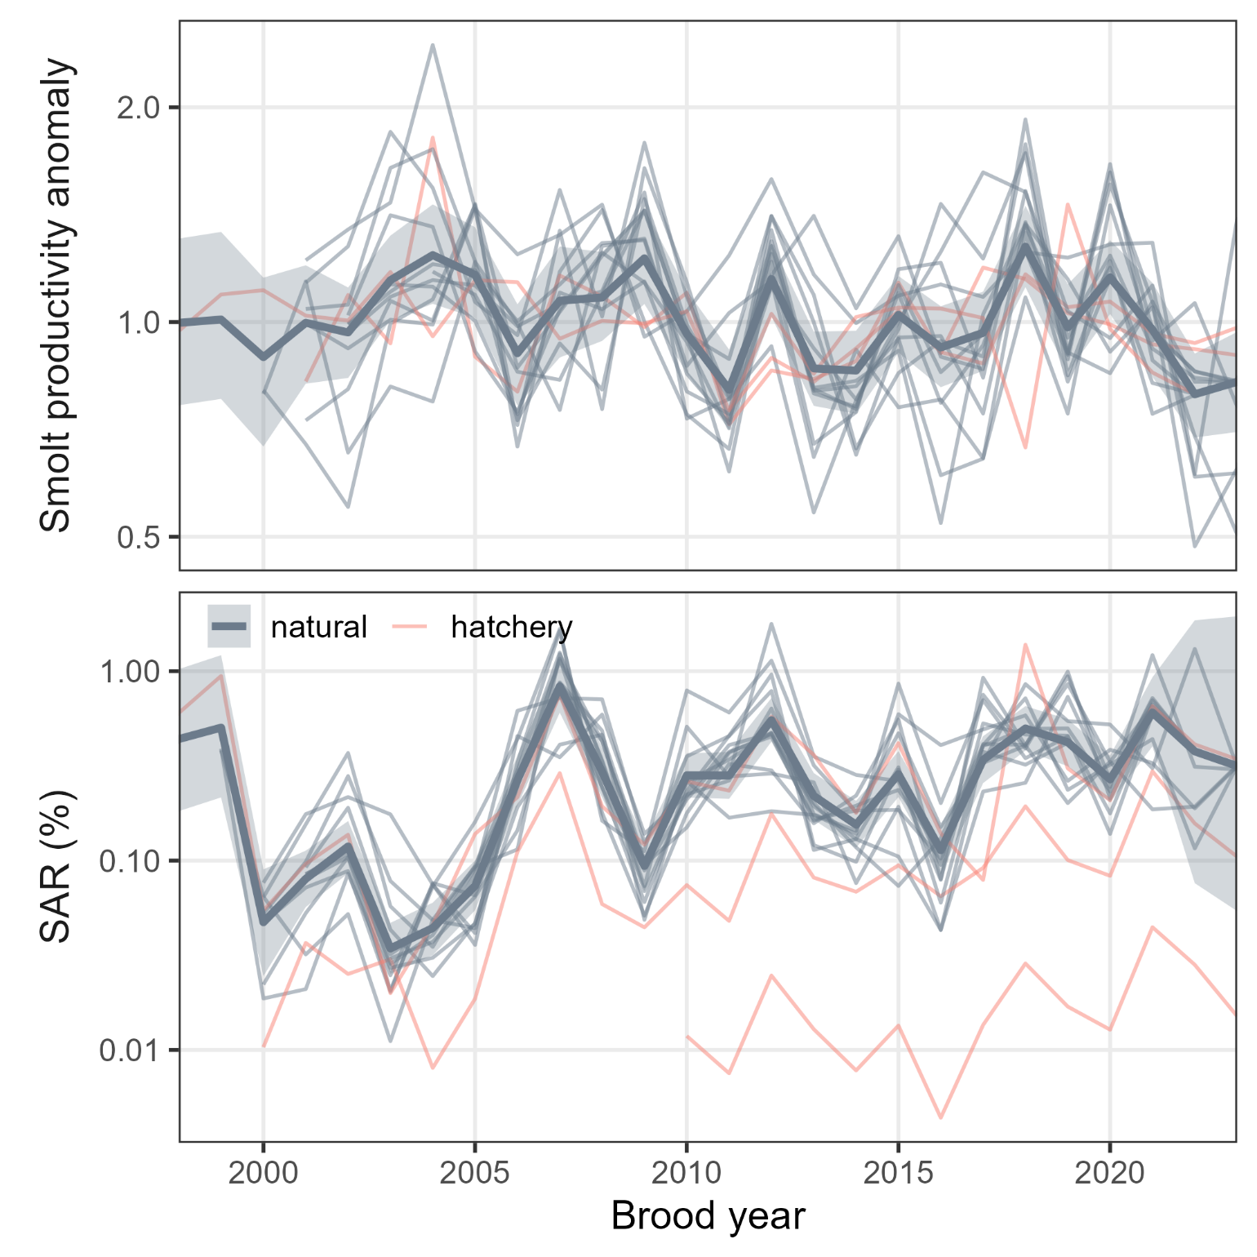
Grays
Duncan
Lewis

Slide 9
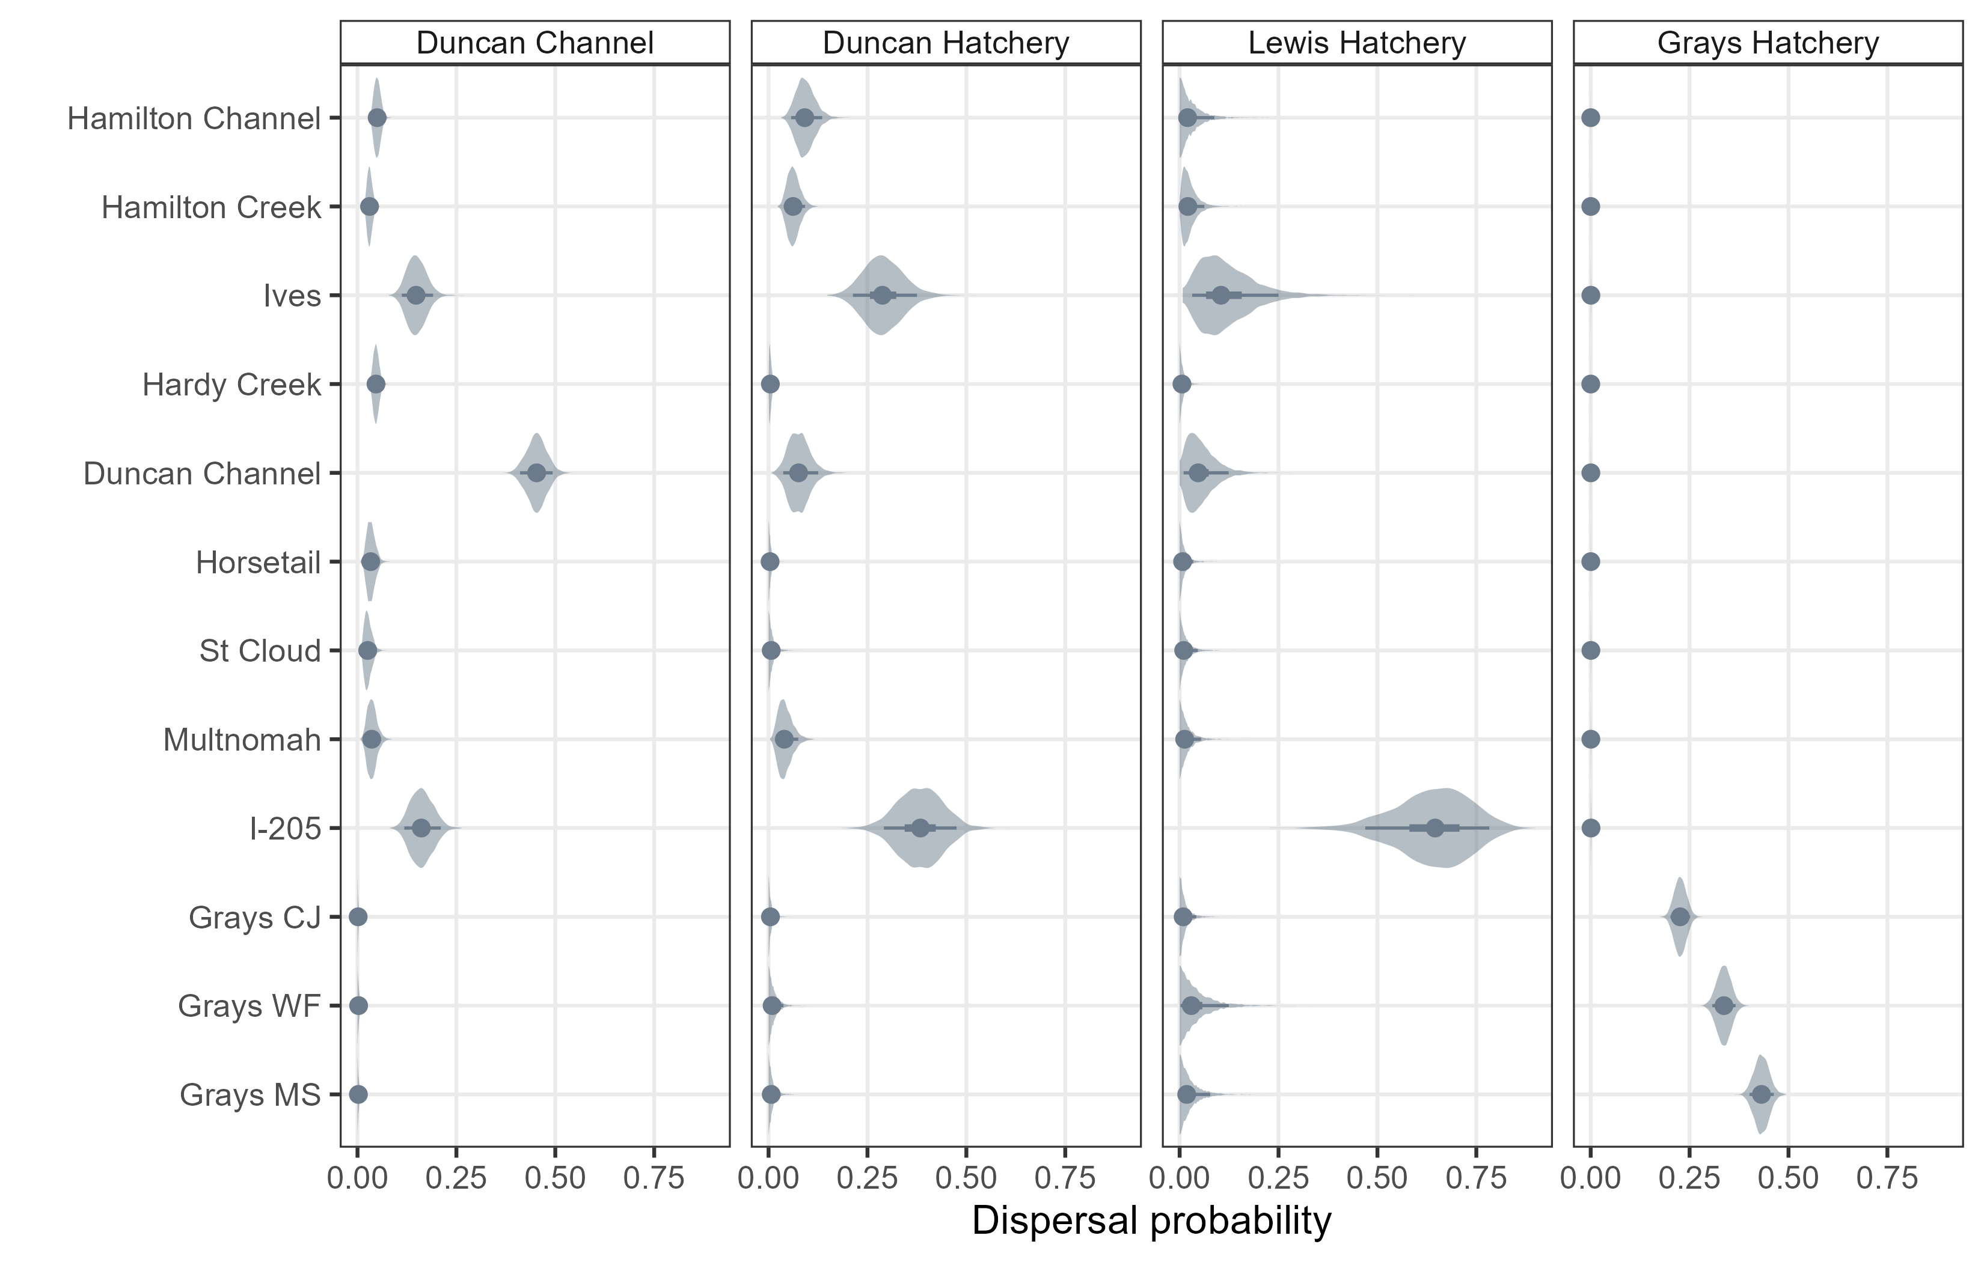

Slide 10
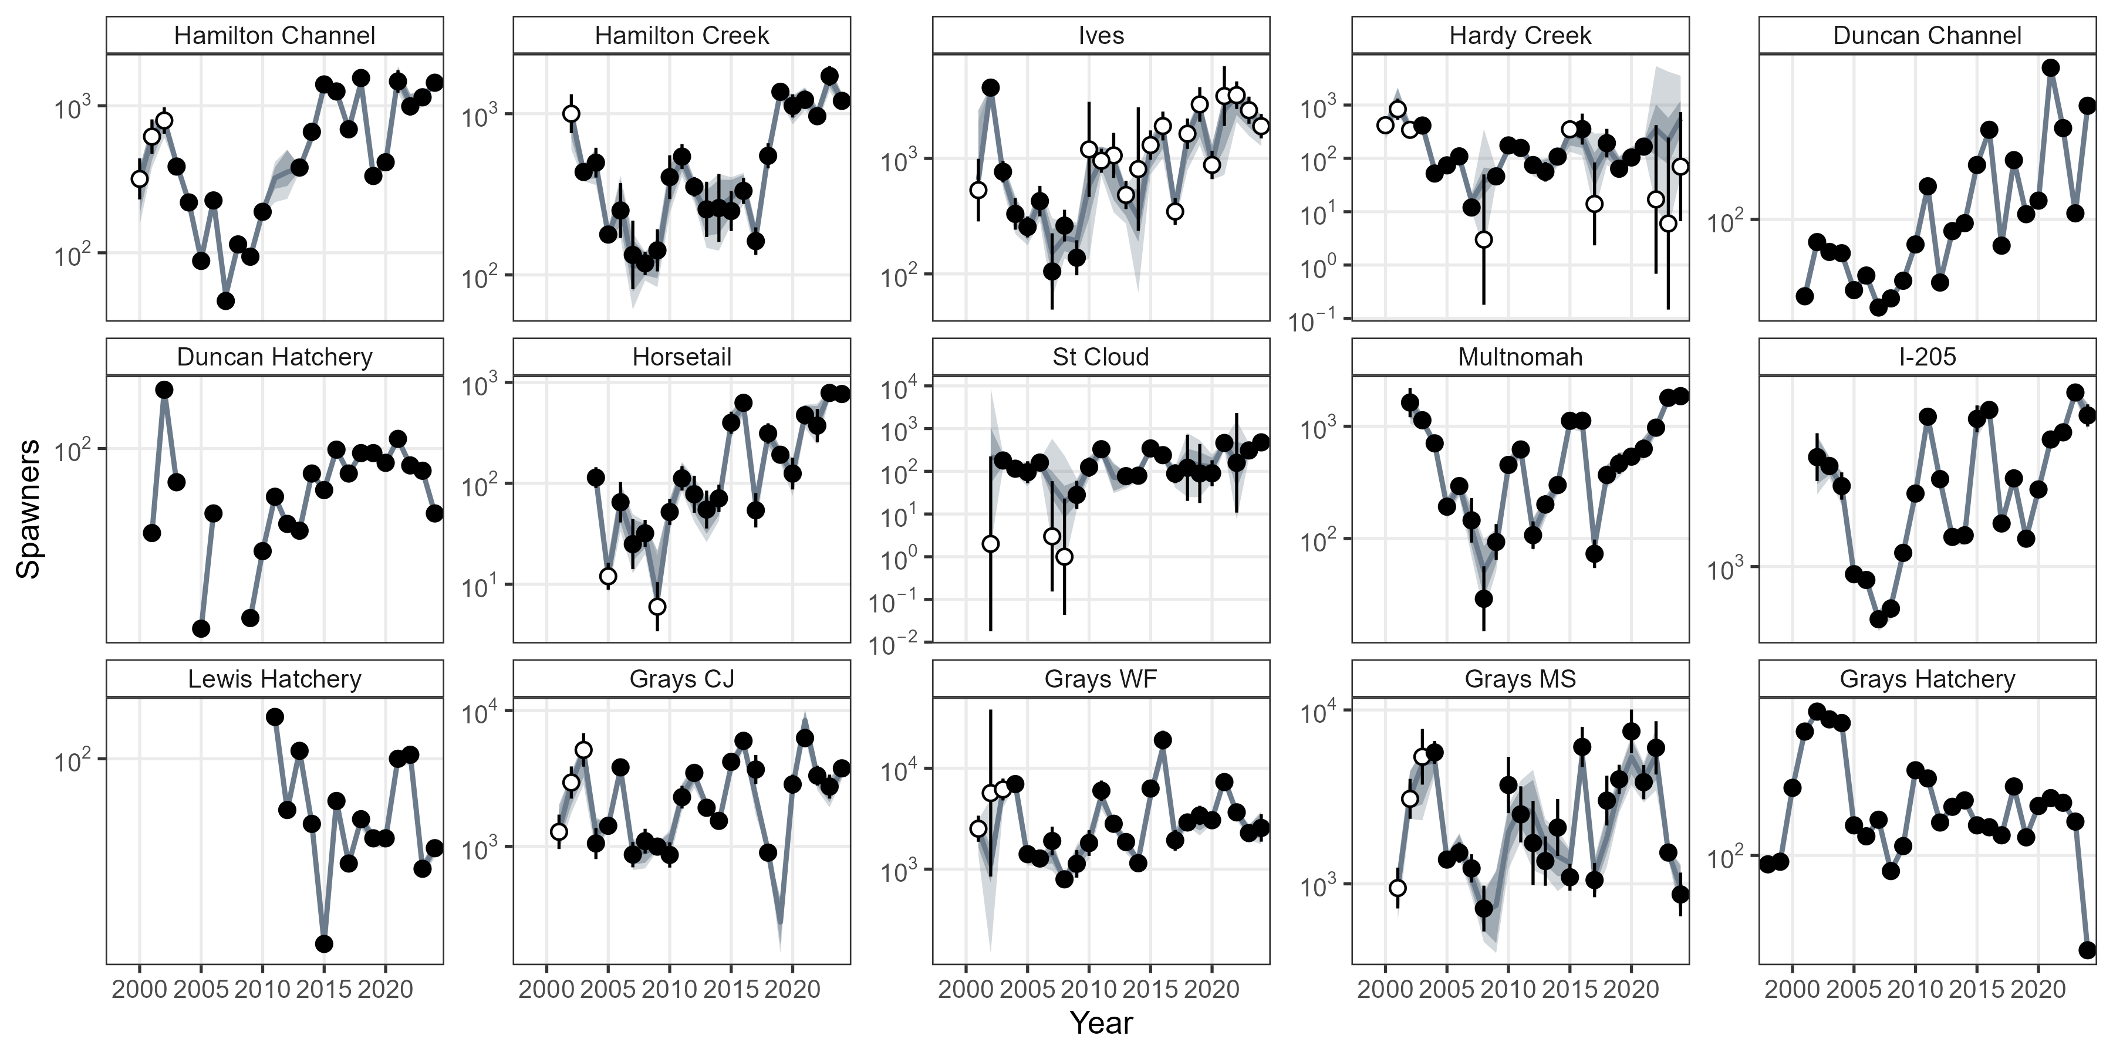

Slide 11
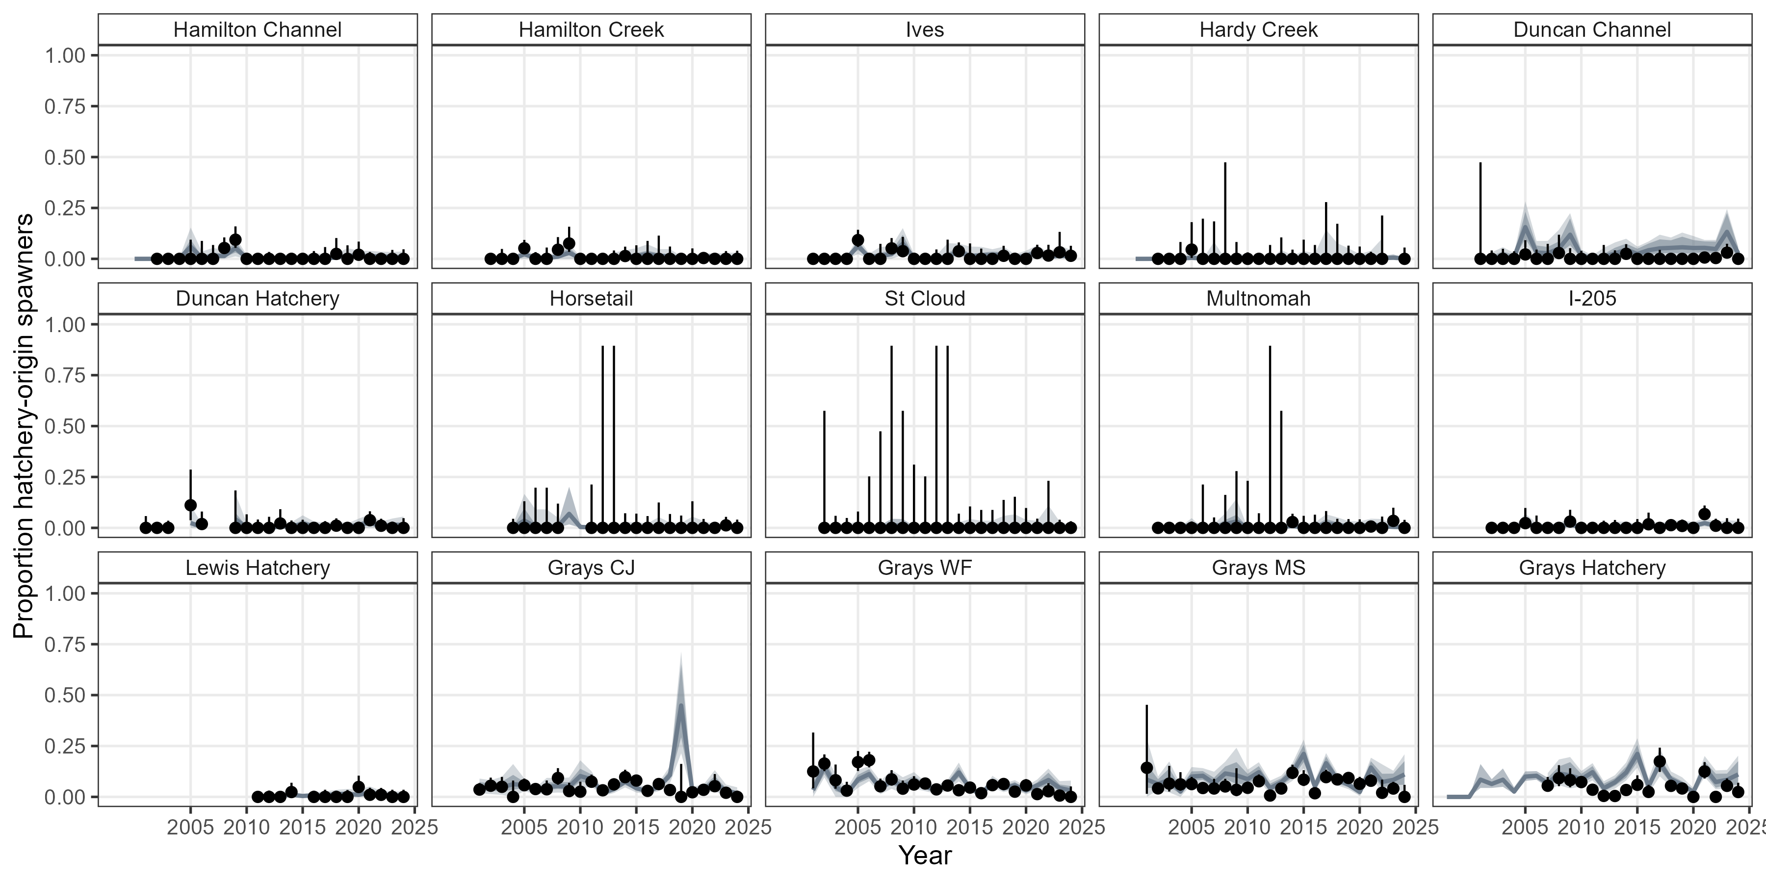

Slide 12
Issues (Open)
Grays Basin spawner-recruit estimates
  Sensitive to details of which data are included
Grays CJ 2019 p_{HOS}
  Solution would be to allow time-varying hatchery p_{D}
Duncan Channel p_{HOS}
  Solution would be to allow NOR straying??
Unique hyper-mean SAR for each hatchery program
  Not ideal, but no viable alternatives so far
Hatchery spawner and smolt observation error SDs
  Currently assuming τ_{S} = 0.01, τ_{M} = 0.05 → any empirical guidance?
Natural smolt and spawner abundance estimates
  Revisit methodology?

Slide 13
2026-27 Statement of Work
Finalize hatchery / translocation life cycle component
Annual reporting metrics framework
Include habitat and environmental drivers
Expand the data set to additional populations
Draft manuscript on retrospective modeling

Slide 14
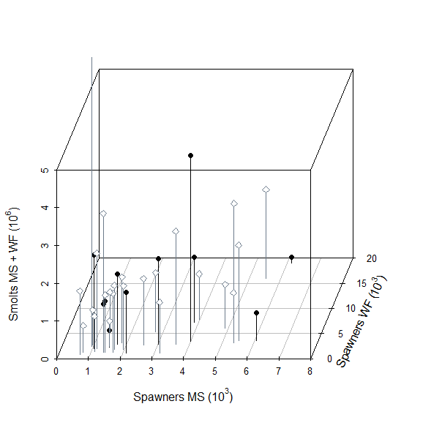

Slide 15
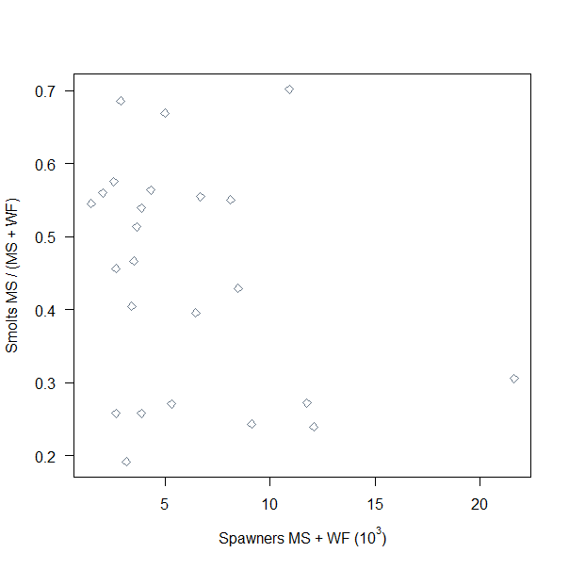

Slide 16


